Slide 1
Paper #3
Santoro, et al.
Joint Framework For Motion Validity and Estimation using Block Overlap
Ashwin A Shenoi
Guru Das Srinagesh

Slide 2
Introduction
Motion estimation - a ill posed problem
3-D scene projected onto a 2-D plane
Complex motion in the scene.
MVs need to be assigned confidence values
This paper uses the concept of block overlap to determine MV validity

Slide 3
Motion Estimation - A non-convex problem
Block matching is used for motion estimation (Optical flow is computation-intensive)
Large-Small block size tradeoff problem sort of mitigated by using hierarchical block matching
The SAD metric is used for block matching - nonconvex problem
Block overlap concept introduced as a way of choosing between local minima

Slide 4
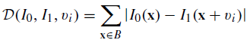
SAD minimization
Above term is the SAD error.
Gives multiple MV’s with the same SAD error due to non-convex nature of the problem

Slide 5
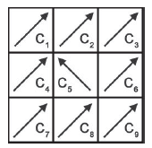
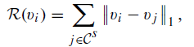
Smoothing term
This term takes into account that the motion has to be smooth.

Slide 6
Energy minimization-1
Using the above two terms, the term to be minimized is:
Since both terms suffer from the non-convex problem this does not give optimal solution

Slide 7
Energy Minimization-2
Paper introduces a block overlap approach gives an optimal solution

Slide 8
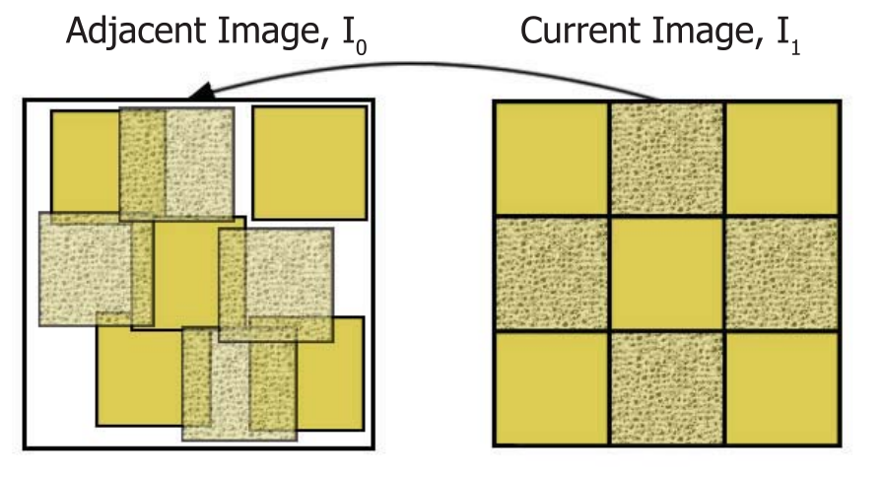
Block mappings for real images
x = Position of a block in I₁
y = Position of MC block in I₀ = x + v, where v is the MV.
I₁ is divided into a grid of square blocks of size B_{S}

Slide 9
Block Overlap: Motivation
Motion estimation between two images:
MVs should map each pixel in the reference image to a unique position in the adjacent image.
In case of occlusion/scaling/other complex motion, unique pixel mapping may not be possible
Blocks may overlap in the compensated image
Main Idea: Find the set of Motion vectors which have least amount of overlap

Slide 10
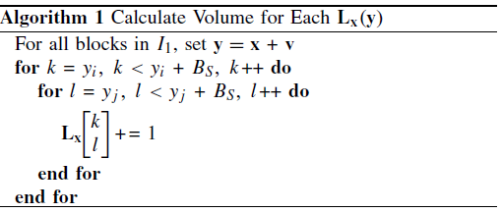
Block overlap calculation

Slide 11
Derivation of metric
Key idea
degree of overlap = uncertainty in the motion estimation decision
validity of a given MV will depend on the amount to which its MC block overlaps with other MC blocks.
When blocks in I₀ overlap, a volume (perhaps nonuniform) is generated.
This is denoted as L_{x}(y), the overlap at position y mapped from x.
The degree of overlap for the block at position y is given by the ratio B_{S}²/L_{x}(y)
A large ratio indicates less/no overlap and so a higher confidence in MV v.

Slide 12
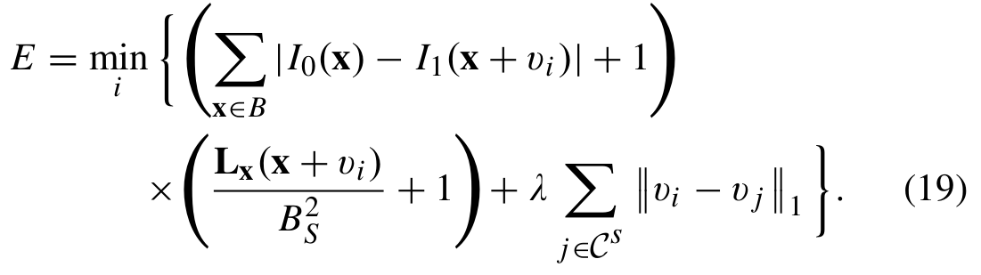
(Derivation contd.) Energy minimization

Slide 13
Advantages
Gives a smoother MV compared to eq (12)
Sensitivity to Block size is reduced a lot.

Slide 14
Motion Estimation
A given image is upsampled 4 times and given to the previous algorithm.
This gives us quarter-pixel motion vectors.

Slide 15
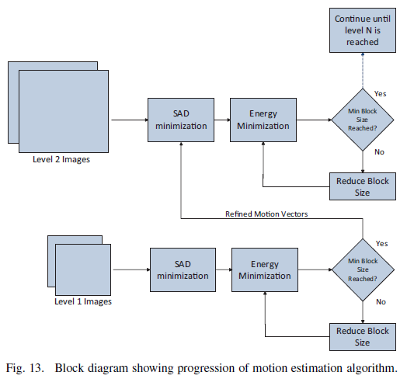
Motion estimation Algorithm

Slide 16
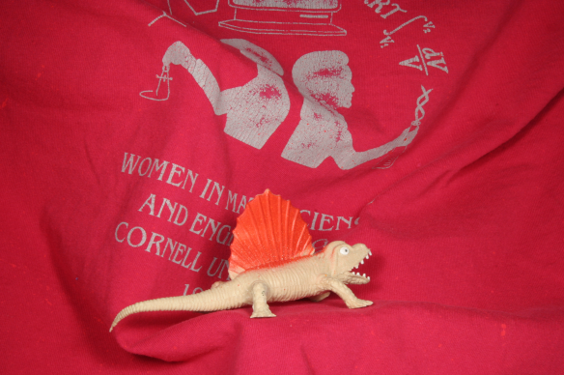
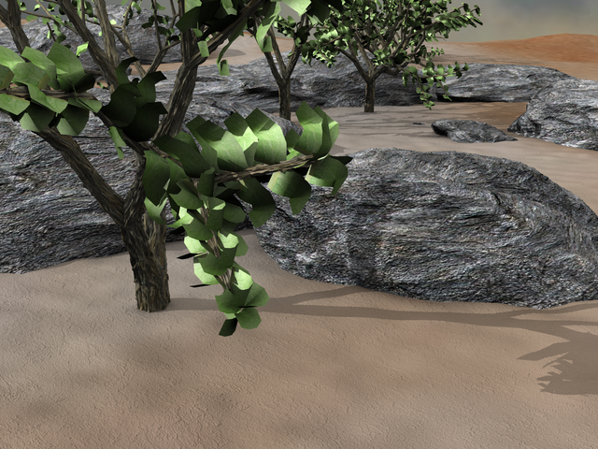
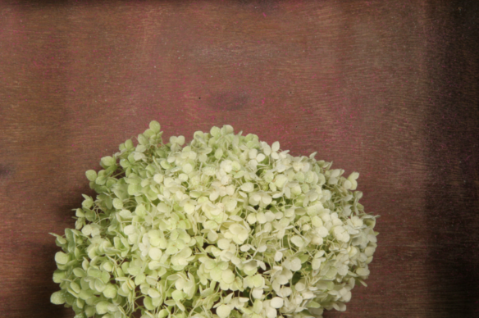
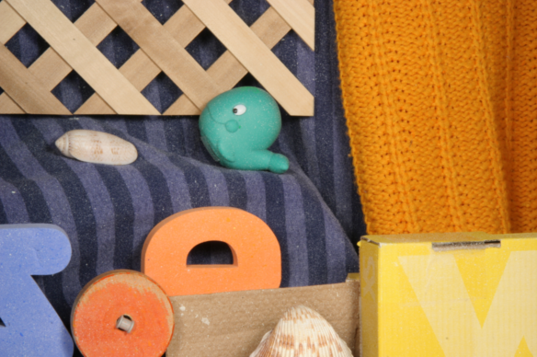
DIMETRODON
GROVE 2
HYDRANGEA
RUBBER WHALE

Slide 17
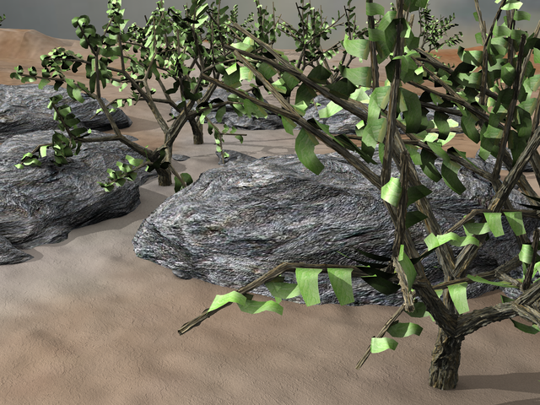
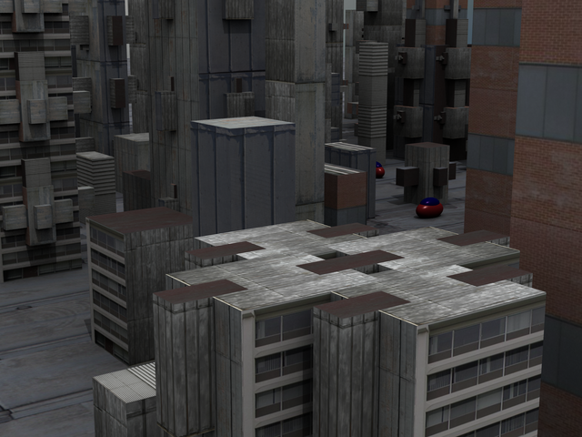
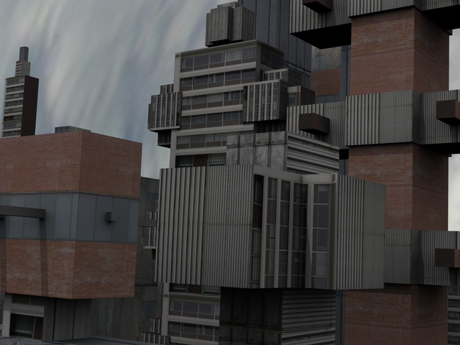
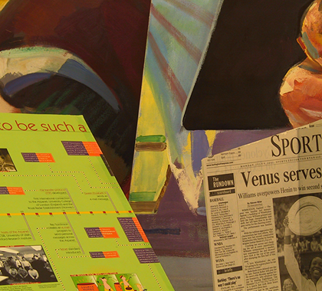
GROVE 3
URBAN 2
URBAN 3
VENUS

Slide 18
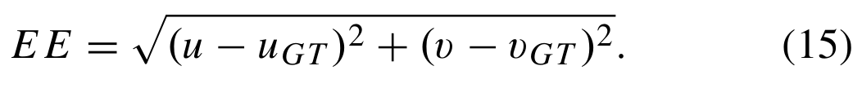
Middlebury data “ground truth”
Dataset displayed on previous pages was from:
http://vision.middlebury.edu/flow/data/
Ground truth: Actual motion vectors obtained by Middlebury
Endpoint error = Average[Norm (our MVs - their MVs)]

Slide 19
Results
Sequence | EE (19) | EE (12) | Improv. (dB) | EE (19) | EE (12) | Improv. (dB)
DIMETRODON | 0.215 | 0.215 | 0.00 | 0.208 | 0.208 | 0.00
GROVE 2 | 0.202 | 0.254 | 0.98 | 0.226 | 0.232 | 0.12
GROVE 3 | 0.618 | 0.683 | 0.43 | 0.649 | 0.744 | 0.59
HYDRANGEA | 0.230 | 0.230 | 0.00 | 0.234 | 0.229 | -0.08
RUBBER WHALE | 0.161 | 0.161 | 0.00 | 0.180 | 0.191 | 0.25
URBAN 2 | 0.418 | 0.472 | 0.53 | 0.500 | 0.562 | 0.50
URBAN 3 | 0.662 | 0.897 | 1.32 | 0.767 | 0.980 | 1.06
VENUS | 0.315 | 0.330 | 0.20 | 0.315 | 0.340 | 0.33

Slide 20
Results
Possible reasons for different results:
Different parameters used like :
Block size
Search window
Boundary_min value used for cost calculation

Slide 21
What we tried to do differently
Initial SAD minimization gives multiple MV candidates due to the non-convex nature of minimization.
Found such candidates and used the average of these candidates.
Not a very significant improvement in results

